Slide 1


Coursework
Java_2
Sang Haotian 16722022
Notes:
亮亮图文旗舰店https://liangliangtuwen.tmall.com

Slide 2
Random Name & Age
String randomName;
String firstName = "",secondName = "";
firstName= firstName+ (char)(int)(Math.random()*26+65);
for(int i=0; i<nameLength; i++) {
secondName = secondName + (char)(int)(Math.random()*26+97);
}
randomName = firstName.concat(secondName);
int age ;
age = (int)(1+Math.random()*(100));
return age;
PART
String name = "Tom";
name = name + nameNum;
nameNum+=1;

Slide 3
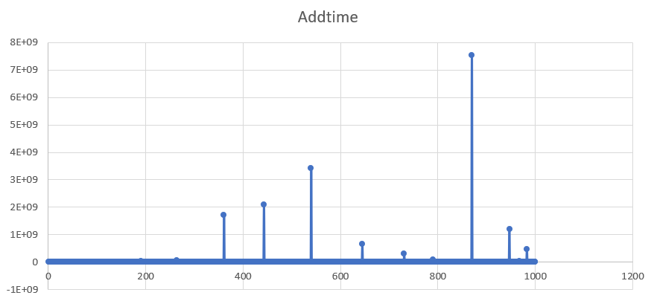
ArrayList_Add
Add to the tail directly, so time complexity O(1)
Temporal
complexity: O(1)
PART
Add 1 million items
Record 1000 points from whole procedure
Distance between each point is 1000
ns

Slide 4
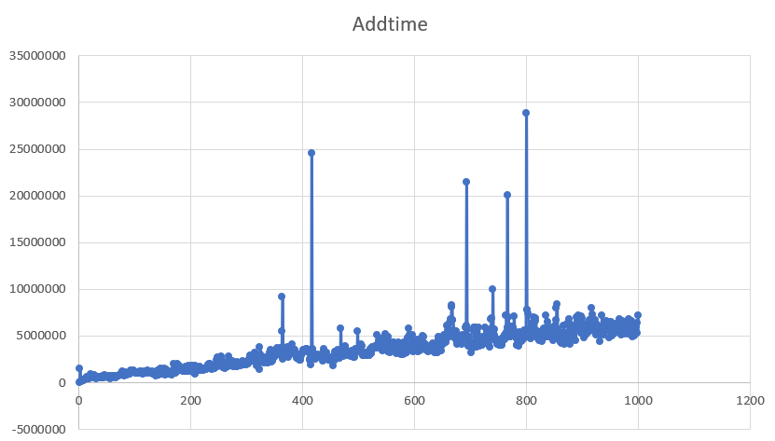
ArrayList_Add
Temporal
complexity: O(1)
PART
Add 100 million items
Record 1000 points from whole procedure
Distance between each point is 1000
ns

Slide 5
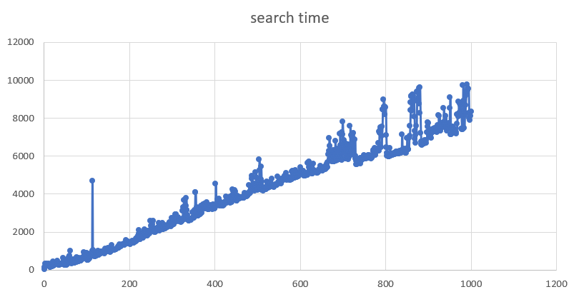
ArrayList_Search
Iterate the whole list to find, so time complexity O(n)
Temporal
complexity: O(n)
PART
Search from1 million items
Record 1000 points from whole procedure
Distance between each point is 1000
ums

Slide 6
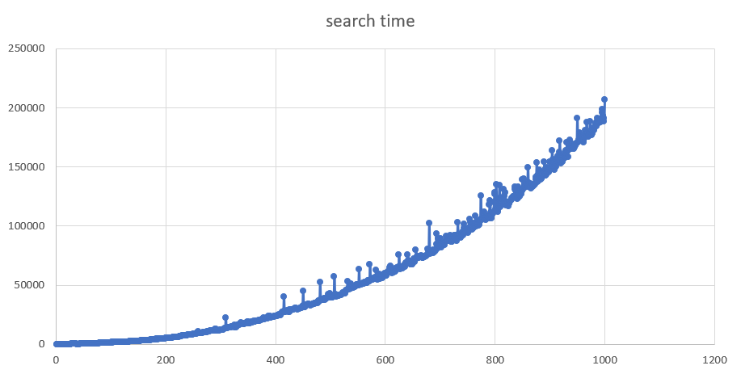
ArrayList_Search
Temporal
complexity: O(n)
PART
Search from1 million items
Record 100 points from whole procedure
Distance between each point is 100
ums

Slide 7
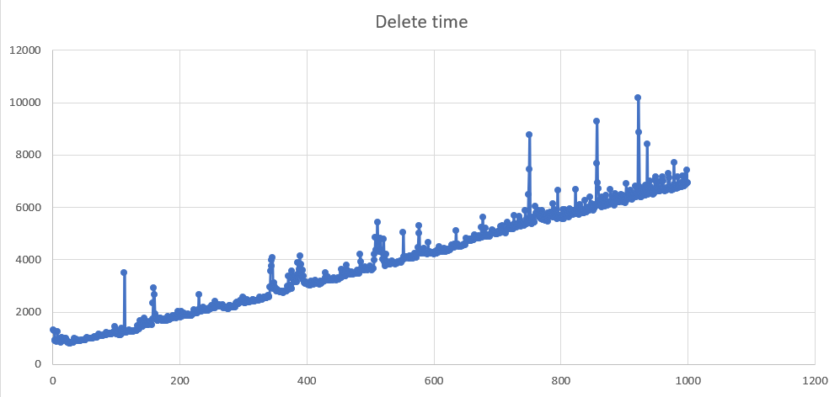
ArrayList_Delete
Deletes the specified element, and the subsequent element moves forward, so time complexity O(n)
Temporal
complexity: O(n)
PART
Delete from1 million items
Record 1000 points from whole procedure
Distance between each point is 1000
ums

Slide 8
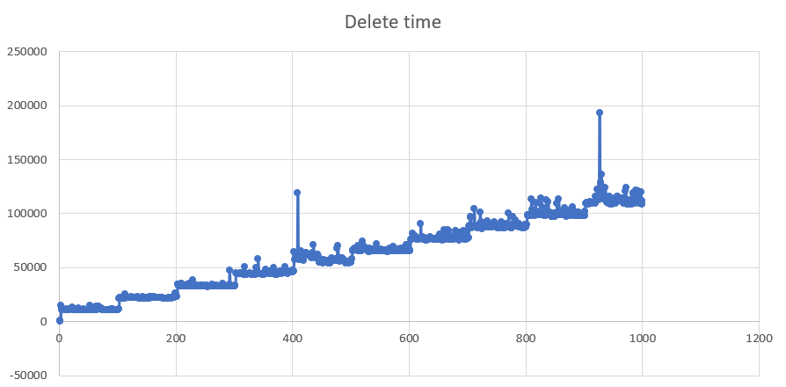
ArrayList_Delete
Temporal
complexity: O(n)
PART
Delete from1 million items
Record 1000 points from whole procedure
Distance between each point is 100
ums

Slide 9
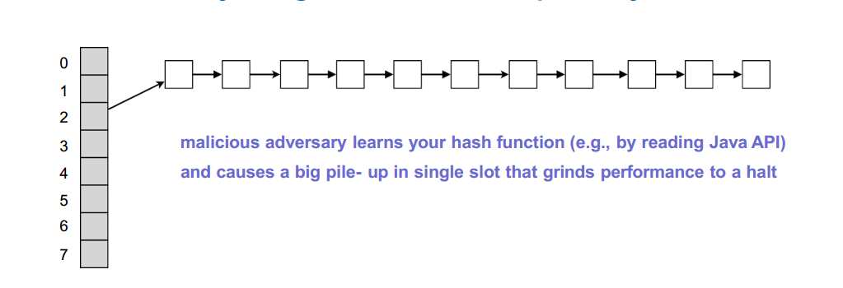

Hashmap
PART
Hash retrieval : 1. Use hashing function to compute index; 2. Search in array element to see if there is a match

Slide 10
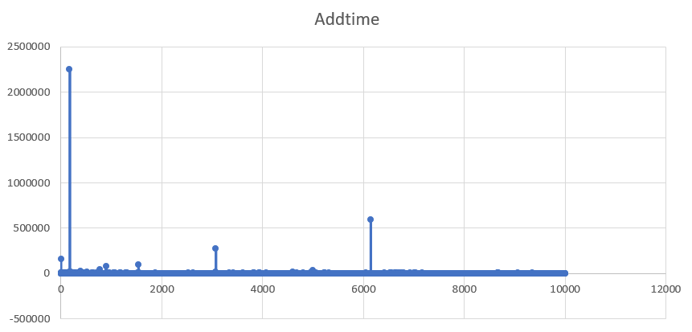
Hashmap_Add
Use the internal key to add, so time complexity O(1)
Temporal
complexity: O(1)
PART
Add 1 million items
Record 10000 points from whole procedure
Distance between each point is 1000
ums

Slide 11
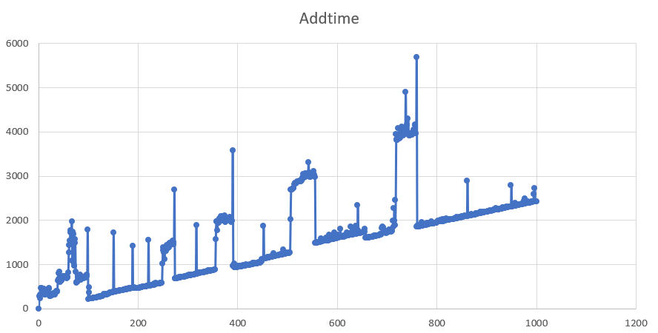
Hashmap_Add
Temporal
complexity: O(1)
PART
Add 1 million items
Record 1000 points from whole procedure
Distance between each point is 1000
ums

Slide 12
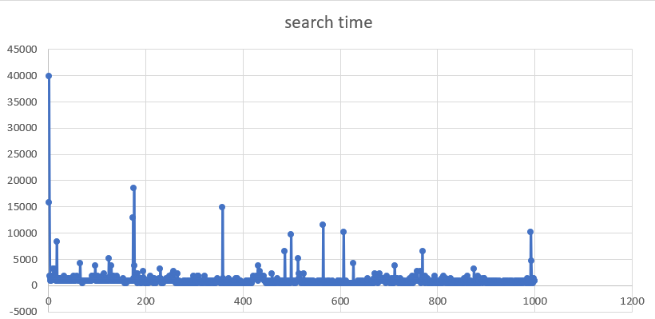
Hashmap_Search
Use the internal key to search, so time complexity O(1)
Temporal
complexity: O(1)
PART
Search from1 million items
Record 10000 points from whole procedure
Distance between each point is 1000
ns

Slide 13
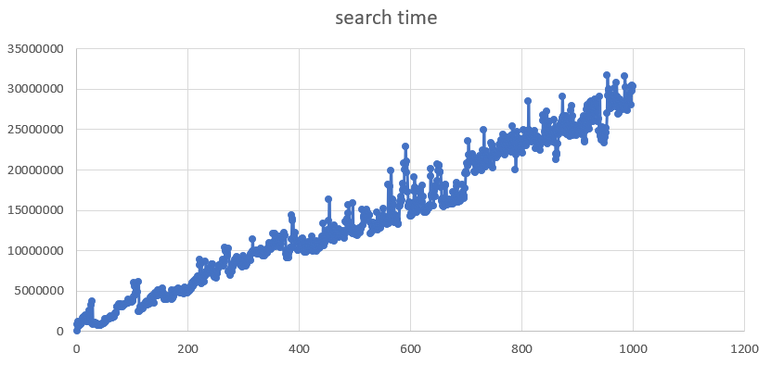
Hashmap_Search
Temporal
complexity: O(1)
PART
Search from1 million items
Record 1000 points from whole procedure
Distance between each point is 100
ns

Slide 14
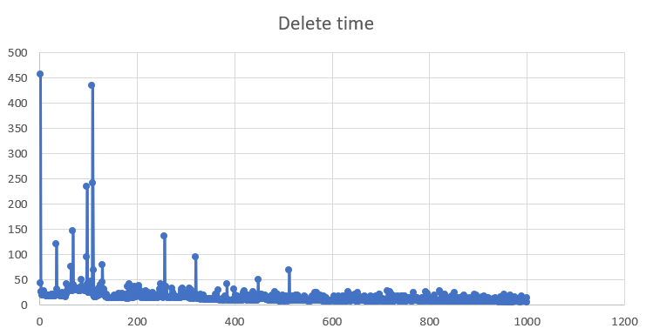
Hashmap_Delete
Use the internal key to delete, so time complexity O(1)
Temporal
complexity: O(1)
PART
Delete from 1 million items
Record 10000 points from whole procedure
Distance between each point is 1000
ums

Slide 15
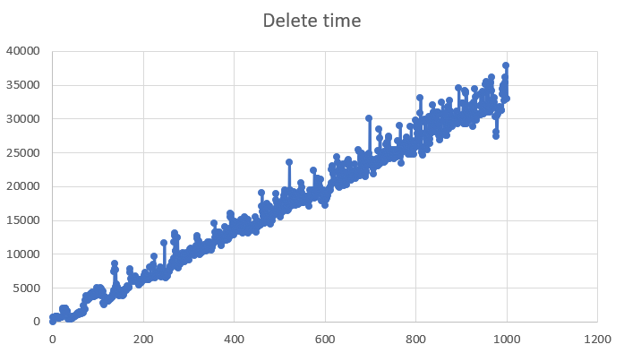
Hashmap_Delete
Temporal
complexity: O(1)
PART
Delete from 1 million items
Record 1000 points from whole procedure
Distance between each point is 100
ums

Slide 16
THANK YOU
Sang Haotian 16722022
Notes:
亮亮图文旗舰店https://liangliangtuwen.tmall.com

